Slide 1
Topics
Power/ground routing.
Clock routing.
Floorplanning tips.
Off-chip connections.

Slide 2
Power distribution
Must size wires to be able to handle current—requires designing topology of V_{DD}/V_{SS} networks.
Want to keep power network in metal—requires designing planar wiring.

Slide 3
Low-resistance jumper
We want to avoid this:

Slide 4
Interdigitated power and ground lines
V_{DD}
V_{SS}

Slide 5
Power tree design
Each branch must be able to supply required current to all of its subsidiary branches:
  I_{x} = Σ _{b ε x} I_{b}
Trees are interdigitated to supply both sides of power supply.

Slide 6
Planar power/ground routing theorem
Draw a dividing line through each cell such that all V_{DD} terminals are on one side and all V_{SS} terminals on the other.
If floorplan places all cells with V_{DD} on same side, there exists a routing for both V_{DD} and V_{SS} which does not require them to cross.
cell
V_{SS}
V_{DD}
V_{SS}
V_{DD}

Slide 7
Planar routing theorem example
cut line
B
V_{DD}
V_{SS}
V_{DD}
C
V_{SS}
no cut line
A
V_{DD}
cut line
V_{SS}
V_{DD}
V_{SS}
V_{DD}
V_{SS}
no connection

Slide 8
Power supply noise
Variations in power supply voltage manifest themselves as noise into the logic gates.
Power supply wiring resistance creates voltage variations with current surges.
Voltage drops on power lines depend on dynamic behavior of circuit.

Slide 9
Tackling power supply noise
Must measure current required by each block at varying times.
May need to redesign power/ground network to reduce resistance at high current loads.
Worst case, may have to move some activity to another clock cycle to reduce peak current.

Slide 10
Clock distribution
Goals:
  deliver clock to all memory elements with acceptable skew;
  deliver clock edges with acceptable sharpness.
Clocking network design is one of the greatest challenges in the design of a large chip.

Slide 11
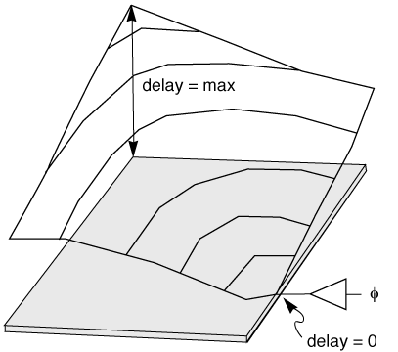
Clock delay varies with position

Slide 12
H-tree
φ

Slide 13
Clock distribution tree
Clocks are generally distributed via wiring trees.
Want to use low-resistance interconnect to minimize delay.
Use multiple drivers to distribute driver requirements—use optimal sizing principles to design buffers.
Clock lines can create significant crosstalk.

Slide 14
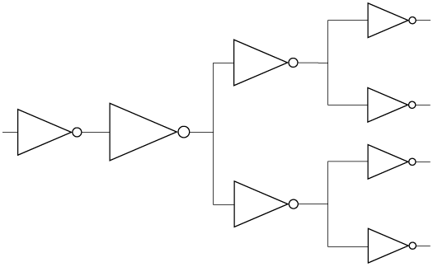
Clock distribution tree example

Slide 15
Floorplanning tips
Develop a wiring plan. Think about how layers will be used to distribute important wires.
Sweep small components into larger blocks. A floorplan with a single NAND gate in the middle will be hard to work with.
Design wiring that looks simple. If it looks complicated, it is complicated.

Slide 16
Floorplanning tips, cont’d.
Design planar wiring. Planarity is the essence of simplicity. It isn’t always possible, but do it where feasible (and where it doesn’t introduce unacceptable delay).
Draw separate wiring plans for power and clocking. These are important design tasks which should be tackled early.

Slide 17
Off-chip connections
A package holds the chip. Packages can introduce significant inductance.
Pads on the chip allow the wires on chip to be connected to the package. Pads are library components which require careful electrical design.

Slide 18
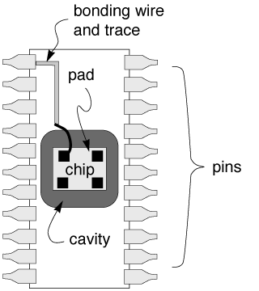
Structure of a typical package

Slide 19
Package structure
Package body is physical/thermal support for chip.
Cavity holds chip.
Leads in package connect to pads, provide substrate connection to chip.

Slide 20
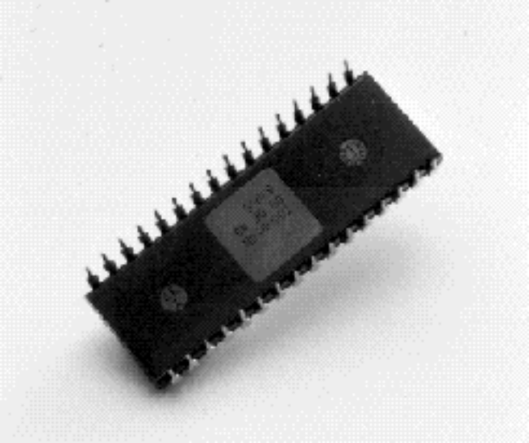
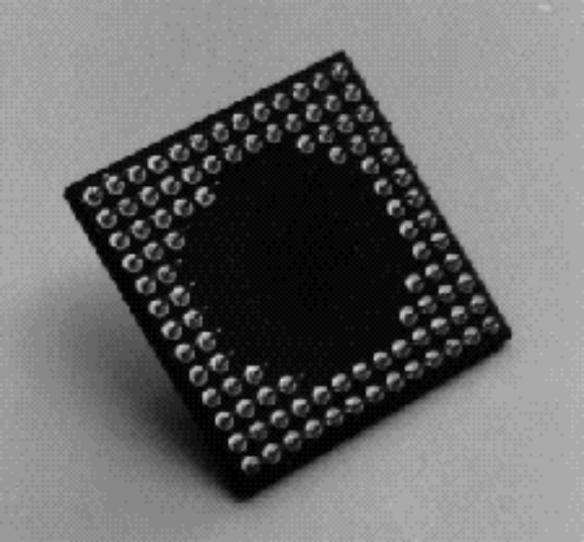
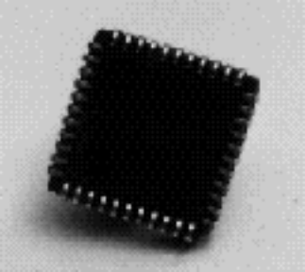
Some packages
DIP
PGA
PLCC

Slide 21
Pin inductance
Package pins have non-trivial inductance.
Power and ground nets typically require many pins to supply required current through the packaging inductance.

Slide 22
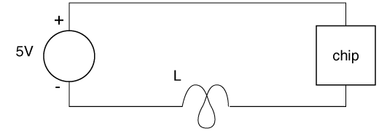
Pin inductance example
Power circuit including pin indutance:

Slide 23
Pin inductance example, cont’d
Voltage across pin inductance:
  v_{L} = L di_{L} / dt
Current surge into chip causes inductive voltage drop:
  L = 0.5 nH;
  i_{L} = 1A;
  v_{L} = 0.5 V.

Slide 24
I/O architecture
Pads are placed on top-layer metal to provide a place to bond to the package.
Pads are typically placed around periphery of chip.
Some advanced packaging systems bond directly to package without bonding wire; some allow pads across entire chip surface.

Slide 25
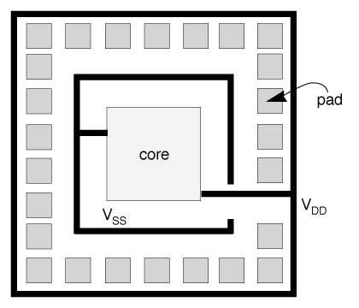
Pad frame architecture

Slide 26
Pad frame design
Must supply power/ground to each pad as well as chip core.
Positions of pads around frame may be determined by pinout requirements on package.
Want to distribute power/ground pins as evenly as possible to minimize power distribution problems.

Slide 27
Input pads
Main purpose is to provide electrostatic discharge (ESD) protection.
Gate voltage of transistor is very sensitive—can be permanently damaged by high voltage.
Static electricity in room is sufficient to damage CMOS ICs.

Slide 28
Input pad circuits
Resistor is used in series with pad to limit current caused by voltage spike.
May use parasitic bipolar transistors to drain away high voltages:
  one for positive pulses;
  another for negative pulses.
Must design layout to avoid latch-up.

Slide 29
Output pad circuits
Don’t need ESD protection—transistor gates not connected to pad.
Must be able to drive capacitive load of pad + outside world.
May need voltage level shifting, etc. to be compatible with other logic families.

Slide 30
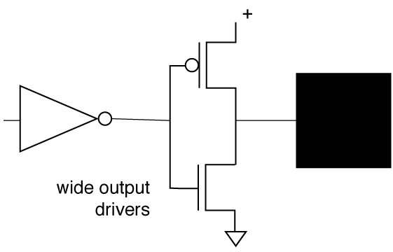
Output pad circuit, cont’d.

Slide 31
Three-state pad
Combination input/output, controlled by mode input on chip.
Pad includes logic to disconnect output driver when pad is used as input.
Must be protected against ESD.

Slide 32
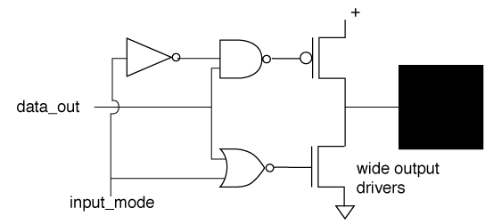
Three-state pad circuit

Slide 33
Boundary scan
Boundary scan is a technique for testing chips on boards. Pads on chips are arranged into a scan chain that can be used to observe and control pins of all chips.
Requires some control circuitry on pads along with an on-chip controller and boundary-scan-mode control pins.

